Slide 1
Ethics and Engineering: Gender Discrimination & Sexual Harassment
WELCOME!

Slide 2
Learning Objectives
Understand relevant terminology and concepts
Understand implicit biases and how they develop automatically
Learn the prevalence and impacts of (i) gender discrimination and (ii) sexual harassment in engineering
Learn how to prevent self and others from (i) gender discrimination and (ii) sexual harassment

Slide 3
1. Concepts and Terminology

Slide 4
Implicit Bias & Gender Discrimination
Cognitive Factors
Categorization effects
Confirmation bias
External vs. Internal attributions
Out-group homogeneity
Affective Factors
In-group favoritism and out-group denigration
Preference for homogenous social circles
Perceived status threat
Desire to maintain status quo
Notes:
An ingroup is a social group to which a person psychologically identifies as being a member. By contrast, an outgroup is a social group to which an individual does not identify.
Provide examples of each of these, which should be easy to come up with (maybe continue with engineering vs. liberal arts students example). I’m also providing some neat in-class experiments/demonstrations if there’s time.
Categorization Effects
Rate people from your team relative to the class, or rate people within engineering compared to the A&M student body from 1-100 on a list of positive traits (e.g., kind, happy intelligent). Most students will choose numbers greater than 100% on average.
Mere categorization of people into groups is sufficient to increase attraction to those in our group and devalue members outside of our group (e.g., you’re also more likely to favor those within your specific subfield of engineering.
Confirmation Bias:
We’re more likely to remember behaviors that we observe from the out-group that confirm our stereotypes, and forget behaviors that disconfirm those stereotypes.
External vs. Internal Attributions
In-Class Experiment: Pick somebody from your group/class and rate them from 1 to 100 on big-5 personality traits. Then rate yourself on these traits. Students will use more extreme scores for others. The same difference can be seen in how we view in-group vs. out-group members.
We are also more likely to ascribe stable, internal attributions to outgroups members while recognize and ascribe situational or external attributions to ingroups members.
Out-group Homogeneity
We’re also more likely to view outgroup members as homogenous, while recognizing the variability within our ingroups.
In sum, if we see an out-group member engage in a bad behavior, we’re more likely to remember that behavior, ascribe that behavior to negative, stable/internal characteristics, and assume that all people from that group have those characteristics and thereby frequently engage in those bad behaviors.
In-group favoritism and out-group denigration
Although people do sometimes denigrate out-group members, the majority of discrimination that occurs is through providing special favors or benefits to in-group members, which is equally problematic.
Preference for homogenous social circles
We all tend to prefer interacting with and being among others who are similar to others, especially in situations of heightened anxiety or uncertainty.
Perceived Status Threat
Some people view diversity as a zero-sum game. Thus, some of the implicit hostility that people have towards diversity and inclusion initiatives comes from a fear that this will mean they will lose their privilege and societal advantages.
Desire to maintain status quo
Relatedly, people fear change and are motivated to uphold and maintain institutions, even when they are unfair or problematic.
Each of these processes are automatic and are simply how our brains are wired. Thus, if aren’t actively working hard to recognize and counteract these biases, we will be unknowingly perpetuating discrimination towards others.

Slide 5
Prejudice
Stereotypes
Discrimination
Notes:
(Maybe first ask students what they think these words mean)
Stereotype are the Beliefs/cognitions about a group of people (e.g., students in liberal arts (or from UT) are not as smart as those in engineering (or at TAMU))
Prejudice—Attitudes or affective/emotional reactions towards a group of people (e.g., I feel disgust, contempt, or anger when I meet someone from liberal arts (or UT))
Discrimination— Differential behaviors/treatment enacted towards a specific group of people (e.g., I ignore, avoid, or ostracize students in liberal arts (or from UT)).
Stereotypes and prejudices can be implicit or explicit.
Implicit biases are the automatic stereotypes and prejudices that we hold about certain groups that we do not have awareness of or conscious control over.
These biases manifest and lead to discrimination through a number of automatic, evolutionary processes.

Slide 6
2. Implicit Bias
Notes:
Implicit Bias & Gender: https://youtu.be/B94dWS9kG9I

Slide 7
Implicit Association Test
The online Implicit Association Test, a result of collaboration among psychologists from Harvard, the University of Virginia, and the University of Washington, was designed to help test takers assess their unconscious biases.
https://implicit.harvard.edu/implicit/takeatest.html
The test works by assessing how quickly the test taker learns to pair out-group faces with negative vs. positive terms. There are 14 test modules in all, and you can even create your own. Over 6 million people have taken the test.
.
Notes:
Have students take the IAT for race and then reflect. This activity should take 10 minutes to complete. You could also have them complete this before or after class.
If this takes too long, you could also have them watch this video from 1:31-3:30 - https://www.youtube.com/watch?v=cykcpqSpVZo

Slide 8
2. Gender Discrimination

Slide 9
Gender Discrimination
In 2018, women earned 81.1% of what men did (Bureau of Labor Statistics, 2019).
These gaps are even more pronounced for racial minorities; Black women (62%), Latina women (54%), and Native American women (58%) (National Partnership for Women and Families, 2019).
Women are promoted less and “protected” from challenging “stretch assignments”, especially during pregnancy or motherhood (Brown, 2010, Hoobler et al., 2014).
Men with children are rated more positively, while women with children face severe penalties (Heilman & Okimoto, 2007; Fuegan, Biernat, Haines, & Deaux, 2004).
Notes:
*Can start by asking students why they think women are more likely to leave engineering.
With regard to gender, women earn 81% of what men earn within comparable positions. This gap is even more pronounced amongst women of color, with black women earning 62%, Latina women earning 54%, and Native American women earning 58% of what white men earn. These gaps exist even when controlling for various factors such as industry, occupation type, and education level.
Women are promoted less and “protected” from challenging “stretch assignments”, especially after becoming pregnant or having children. Men, on the other hand, experience a “fatherhood bonus”, and are rated more positively after the birth of a child.
Smith, K. N., & Gayles, J. G. (2018). “Girl Power”: Gendered academic and workplace experiences of college women in engineering. Social Sciences, 7(1), 11.
Women in engineering: (women encouraging women and talking about engineering as a field)
https://youtu.be/zkpjJlzF60M
https://alltogether.swe.org/2016/04/women-leave-engineering-swe-gender-culture-study/https://alltogether.swe.org/2016/04/women-leave-engineering-swe-gender-culture-study/
SWE Culture Study: 3:16-End
https://alltogether.swe.org/2016/10/new-study-reveals-gender-racial-bias-engineering - 1:15

Slide 10
Gender Discrimination
Women face the greatest barriers in achieving top-level positions (i.e., glass ceiling effects). As an example, women currently hold 6.6% of all CEO positions at Fortune 500 companies (2019).
Women face challenges in obtaining leadership positions, but also in being viewed and respected as leaders.
Notes:
These reduced salaries and barriers to promotion are often seen in a phenomenon known as the glass ceiling effect. This refers to the fact that women experience barriers in achieving top-level positions within organizations. In 2019, only 6.6& of CEO positions at Fortune 500 companies were held by women.
Not only do women face challenges in obtaining these positions, they also experience pushback and resistance to serving in these positions.
One study found that when people are asked to identify the leader of a group from a picture of men sitting around an oval table, they almost always chose the man sitting at the head. When shown an identical picture except with a woman sitting at the head, people usually choose one of the men sitting on the side of the table (Porter, Lindauer Geis, & Jennings, 1983). Thus, women clearly face barriers to being perceived as leaders.

Slide 11
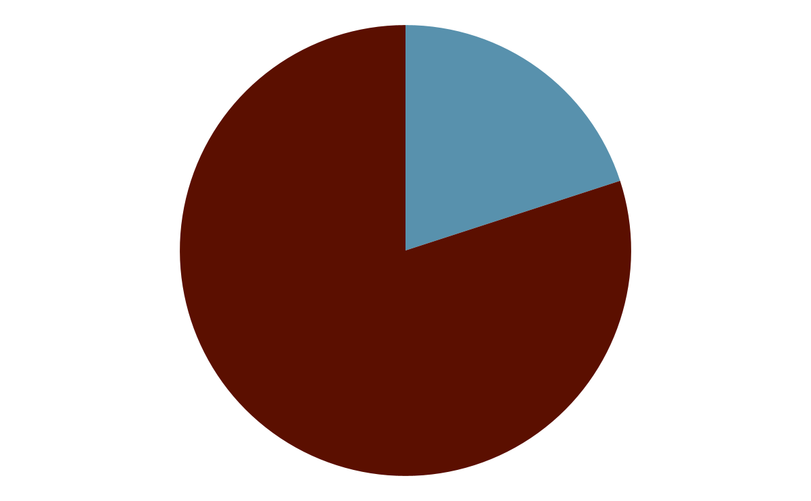
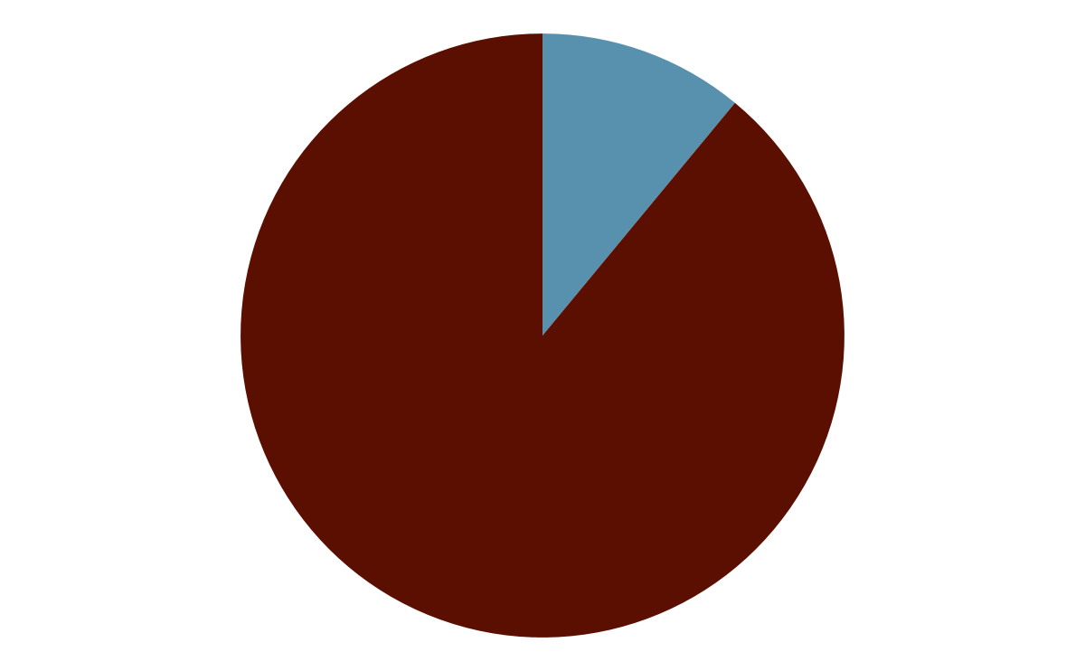
Gender Discrimination
Women are 20% of Engineering School Graduates
Women are only 11% of Practicing Engineers
Notes:
Within engineering, The Society of Women Engineers found that although women account for 20% of engineering school graduates, they only make up 11% of practicing engineers. Thirty percent of the women who left cited hostile workplace climates as a primary motivating factor.

Slide 12
Gender Discrimination on Campus
“I was offered an academic scholarship to attend [university] so my Mom took me there to check out the campus and talk to an academic advisor. He promptly discouraged me from the engineering program. I left and never looked back. I’ve had my BSEE for 28 years.”
“Shout out to the sexist boy in my health 210 class, when I said I’m going to nursing school he said ‘of course you are, you’re a girl, you’re not going to be a doctor’ so now I’m going to be a doctor, might go into his field too.”
“Freshman year ENGR 111 class, the prof/dean stood up and told us that the women should leave since we prob wouldn't pass.”
Notes:
Source: @HOTHOB69
Source: @kearradancie
Source: @amyrejo000
Source: @Aesops_Statue

Slide 13
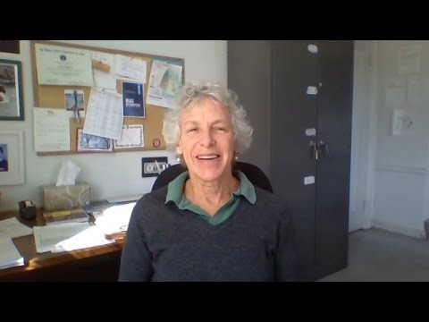
Climate Control Survey
Notes:
https://youtu.be/D8GnyQppSYo - (1:15 to the end)

Slide 14
Demographics of Engineers & Scientists
Notes:
Almost half of all current scientists and engineers are white men. People of color and women are underrepresented, and women of color are especially lacking in these fields. This is likely due to the combination of barriers previously discussed, as well as the intersectional oppressions faced by these groups.
Source: https://www.nsf.gov/statistics/2017/nsf17310/digest/occupation/overall.cfm

Slide 15
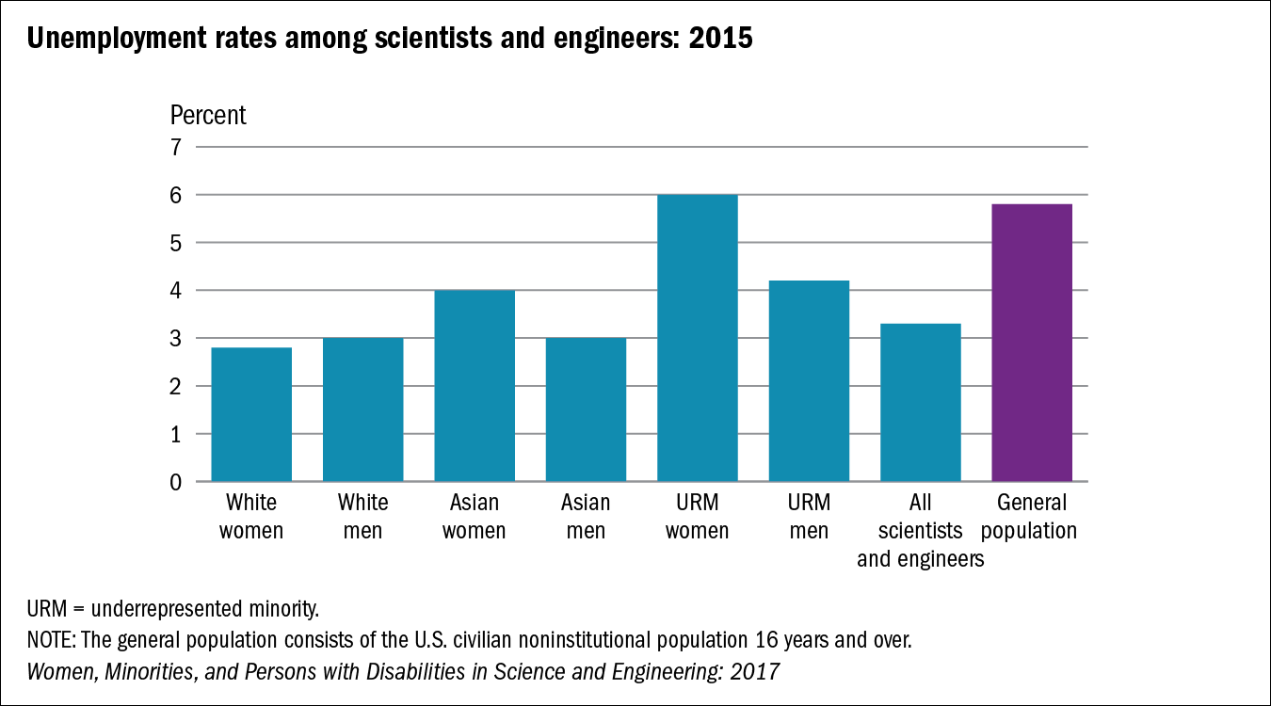
Unemployment Demographics

Slide 16
3. Sexual Harassment

Slide 17
Sexual Harassment
Sexual Harassment
Defined as, “unwelcome sexual advances, requests for sexual favors, and other verbal or physical harassment of a sexual nature” (Equal Opportunity Employment Commission)
Can be verbal, non-verbal, visual, or physical conduct
Notes:
Sexual harassment has been defined by the Equal Employment Opportunity Comission as ‘unwelcome sexual advances, requests for sexual favors, and other verbal or physical harassment of a sexual nature’. While sexual harassment commonly happens to women, anyone can be a victim of sexual harassment.
Harassment is unwelcome and undesired. While people are aware that sexual coercion and unwanted physical touch are forms of sexual harassment, they may not know that pressuring someone for a date, making remarks about a persons body, sexual orientation, or appearance and sexual jokes can all be forms of sexual harassment. Sexual Harassment can occur in a variety of different ways-
Verbal - Sexual teasing or jokes (Even if they are not targeting individuals within the organization), asking someone out repeatedly, using demeaning or gender-based language and insults (Ex. Babe, sexy, slut), and inappropriate comments about someone’s body
Nonverbal - Leering, stalking, derogatory gestures Ex. “At one hackathon, while most of us were in the office late one night and on a video call to someone working remotely, one of the women at the company took time to present her work of the evening. During this, a male coworker (who no longer works at the company) decided to make lewd sexual gestures behind her, as a joke to the remote coworker on the video call.”
Visual – sexually explicit pictures, comics, emails, or texts
Physical – Groping, assault
Sexual harassment is illegal when it creates a hostile working environment or when it is “pervasive and severe”. To be severe, harassment usually has to be more than an once-off instance (with the exceptions of severe behaviors like groping, overt sexual harassment, and instances with major power imbalances). If this “minor” incident is repeated over time it can severely affect your well-being and sense of safety in your environment.
Next, we will discuss the two types of sexual harassment: Quid pro Quo and Hostile Work Environment
Source: National Academies of Sciences, Engineering, and Medicine. (2018). Sexual harassment of women: climate, culture, and consequences in academic sciences, engineering, and medicine. National Academies Press.
Sources: Raj A, Johns NE, Jose R. Gender Parity at Work and Its Association With Workplace Sexual Harassment. Workplace Health Saf. 2020 Jun;68(6):279-292. doi: 10.1177/2165079919900793. Epub 2020 Mar 17. PMID: 32183607.
Hewlett, Sylvia A., Laura Sherbin, Fabiola Dieudonne, Christina Fargnoli, and Catherine Fredman. 2014. Athena Factor 2.0: Accelerating Female Talent in Science, Engineering and Technology. New York: Center for Talent Innovation.

Slide 18
Types of Sexual Harassment
Quid Pro Quo
Expressed or implied demands for sexual favors in exchange for some benefit (e.g., a promotion, pay increase) or to avoid some detriment (e.g., firing, demotion)
Harasser has some sort of power over the person they harass
Hostile Work Environment
Any conduct directed at an employee because of that employee's sex that unreasonably interferes with the employee's work performance or creates an intimidating, hostile or offensive working environment.
Anyone can be a harasser
Notes:
Quid Pro Quo harassment is probably the most form you are most familiar with. This occurs when the harasser (Usually a supervisor) asks for a sexual favor as condition for something. This can occur as a trade of sexual favors for a benefit “If you go out with me I can recommend you for that promotion” or a threat “If you don’t go out with me I’ll reduce your hours”.
The second type of sexual harassment is called a Hostile Work Environment. A hostile work environment can occur as a result of a single aggressive incident but more often is a series of smaller, more “minor” incidents taking place over a series of time. This doesn’t have to involve a person in a position of authority and frequently involves multiple parties.
Sources:
National Academies of Sciences, Engineering, and Medicine. (2018). Sexual harassment of women: climate, culture, and consequences in academic sciences, engineering, and medicine. National Academies Press.
del Carmen Herrera, M., Herrera, A., & Expósito, F. (2017). To confront versus not to confront: Women's perception of sexual harassment. European journal of psychology applied to legal context, 10(1), 1-7.
https://www.womenshistory.org/articles/real-women-north-country
https://law.justia.com/cases/federal/district-courts/FSupp/824/847/1460561/
https://www.sexualharassmenttraining.com/blog/detail/13/what-is-quid-pro-quo-and-hostile-work-environment-sexual-harassment

Slide 19
Which of the following is sexual harassment?
Types of Sexual Harassment
When a new hire tells your co-worker that his sexual joke is not funny, he is told that he is overreacting and needs to relax; nobody else is bothered by the joke.
After a meeting, you overhear your male co-worker say to another male co-worker, ‘I couldn’t take her seriously in that presentation — did you see what she was wearing?’
After a positive performance review, a graduate student invites an undergraduate on a date. When she declines, he refuses to write a recommendation letter for her because he doesn’t think she’s a good fit for the lab culture.
A few times a week you see your straight male co-worker jokingly tell his straight male colleague how hot he looks and whistles whenever his colleague walks by.
After a bank teller is hired, her manager asks her to dinner. She turns down his request. The next day, she notices that her manager has reduced the number of hours she is scheduled for.
A woman at work talks a lot about women- her sexual relationships and famous men she thinks are “hot,” None of your other employees have complained about her.
On Friday after work, a male coworker asks a female co-worker to go out on a date and is turned down. Afterwards, she tells the entire office how unprofessional it was for him to ask.
A new lesbian coworker is asked if her partner is as attractive as she is and how often they have sex.
Notes:
Next, we’re going to do an exercise on identifying sexual harassment in the workplace. For each scenario, write down whether you think it is Quid pro Quo harassment, Hostile Work Environment harassment, or neither. Afterwards, we’ll discuss why each scenario is or isn’t a form of sexual harassment. [Read each scenario outloud]
Hostile Work Environment Work is not the place for sexual jokes, remarks, or comments. This individual incident is sexual harassment.
Not Sexual Harassment This is not sexual harassment but rather an example of sexism. Your coworker is neither requesting sexual favors nor making remarks of a sexual nature.
Quid pro Quo Harassment Even though the graduate student stopped when she declined, he is punishing her because she would not go out with him, making this Quid pro Quo harassment.
Hostile Work Environment Sexual harassment is not always about attraction. Just because your co-worker is heterosexual doesn’t make this behavior okay. By engaging in this behavior, he is creating a hostile work environment.
Quid pro Quo Harassment In this case, the manager seems to be withholding benefits to his subordinate based turning down his advances. This is Quid pro Quo harassment and should be reported.
Hostile Work Environment Even if nobody states they are uncomfortable, tolerating these jokes sends a message that sexual harassment is acceptable in your workplace. These instances do not have to be directed at a specific person to count as sexual harassment.
Not Sexual Harassment Asking a co-worker on a date (in a polite way at an appropriate time) is not necessarily sexual harassment. This would be considered harassment only if the coworker continually asks out or flirts with his colleague.
Hostile Work Environment Discussions about your coworkers sex lives are inappropriate and should not occur in a workplace context. This is sexual harassment and creating a hostile work environment.

Slide 20
Sexual harassment is about power (the ability to influence actions and choices of others), NOT sexual attraction
Notes:
Examples of Power Dynamics:
Position in organization or society, level of ability or privilege
There are several theories as to why people sexually harass. We often assume that sexual harassment occurs because harassers are attracted to their victims. However, the most supported theories are power based, meaning that harassers use sexual harassment as a way to gain or maintain power or because they feel entitled to harass because of their power. When we look at research, we find that people with lower power in society (such as gender, or sexual minorities) or organizations (such as newly employed or lower level employees) as well as those who violate societal norms (including gender nonconforming people and women in traditionally masculine fields) are more likely to experience sexual harassment. Additionally, because harassers often have power over those they harass, workers are less likely to confront someone about their behavior.
Sources:
Burn, S. M. (2019). The Psychology of Sexual Harassment. Teaching of Psychology, 46(1), 96–103. https://doi.org/10.1177/0098628318816183
Malamuth, N. M., & Hald, G. M. Model of Sexual Aggression.
https://www.nsvrc.org/sites/default/files/publications/2019-01/Power%20Dynamics%20Handout_508.pdf

Slide 21
Contributors to workplace Sexual Harassment
A workplace that...
tolerates sexual harassment
does not talk about what sexual harassment is
has high levels of unbalanced power dynamics
Notes:
There have been several factors identified that make a workplace more likely to have sexual harassment. Workplace climates that do not actively work against or call out instances of sexual harassment communicate that harassment is acceptable, allowing harassers to continue or escalate their behavior. Many workplaces do not discuss what behaviors are sexual harassment or who to report harassment to.
The biggest factor found in workplaces with sexual harassment is a high level of unbalanced power dynamics. Positions of power (Like being a supervisor) in the workplace give harassers the ability to affect the victim, creating a situation in which victims don’t feel like they have a choice. In the next slide we’ll talk more about how power dynamics contribute to sexual harassment.
Sources:
Burn, S. M. (2019). The Psychology of Sexual Harassment. Teaching of Psychology, 46(1), 96–103. https://doi.org/10.1177/0098628318816183
Malamuth, N. M., & Hald, G. M. Model of Sexual Aggression.
https://www.nsvrc.org/sites/default/files/publications/2019-01/Power%20Dynamics%20Handout_508.pdf
Burn, S. M. (2019). The psychology of sexual harassment. Teaching of Psychology, 46(1), 96-103.
Sexual Harassment On The Job: What It Is & How To Stop It (4th Ed.), by William Petrocelli, Barbara Kate Repa.

Slide 22
Sexual Harassment in Engineering
Dependence on advisors and mentors for career advancement
Male Dominated
“Macho” cultures
System of meritocracy
Informal communication networks
Organizational tolerance for harassment
Notes:
*Can start by asking students why sexual harassment in STEM/the academy is so high.
There are several aspects of STEM fields that make individuals more likely to be targets of and have less power to speak out about experiences of sexual harassment.
Due to the funding structures of many STEM fields, students work closely with and depend on their advisors to be successful.
As mentioned earlier, these fields are typically male dominated
And have “macho” cultures that reward student for being assertive, aggressive, and dominant. In these environments, sexual harassment is viewed as more acceptable.
Likewise, these fields often operate on strict systems of meritocracy, in which nothing matters except for one’s productivity. As such, issues related to harassment are often ignored and targets can be punished for speaking up.
Relatedly, these fields often rely on informal communication networks, making it difficult for targets who speak out about their supervisors to find alternate employment.
Lastly, these organizations typically have climates that tolerate sexual harassment behaviors. Specifically, leaders (typically male) often fail to take complaints seriously, sanction perpetrators, or protect complainants from retaliation.
Additional video - https://www.youtube.com/watch?v=fTCeIdqzw84 (0:00-1:24)
National Academies of Sciences, Engineering, and Medicine. (2018). Sexual harassment of women: climate, culture, and consequences in academic sciences, engineering, and medicine. National Academies Press.
Bondestam, Fredrik, and Maja Lundqvist. 2020. Sexual Harassment in higher education—A systematic review. European Journal of Higher Education 10: 379–419. [CrossRef]

Slide 23
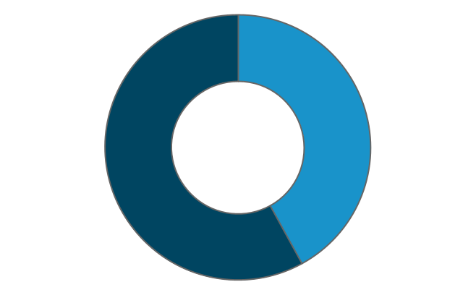
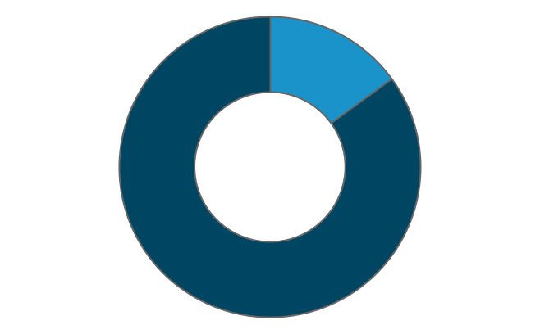
Sexual Harassment
Prevalence of Sexual Harassment in Engineering
Harassment in engineering workplaces:
54% of all female engineering students experience sexual harassment from faculty or staff
57% of female engineers working in offices said they have been sexually harassed
66% of female engineers working in plants said they have been sexually harassed
Experienced by 42%
of Women
Experienced by
15% of Men
Notes:
While sexual harassment commonly happens to women, anyone can be a victim of sexual harassment. 42% of women and 15% of men have experienced sexual harassment in their workplace. This increases by a significant amount when female engineers are surveyed. Despite women only having 14% of engineering jobs, over half of female engineers reported sexual harassment in their workplace. Women in STEM are more likely to report discrimination and experienced sexual harassment.
Sources: Raj A, Johns NE, Jose R. Gender Parity at Work and Its Association With Workplace Sexual Harassment. Workplace Health Saf. 2020 Jun;68(6):279-292. doi: 10.1177/2165079919900793. Epub 2020 Mar 17. PMID: 32183607.
Hewlett, Sylvia A., Laura Sherbin, Fabiola Dieudonne, Christina Fargnoli, and Catherine Fredman. 2014. Athena Factor 2.0: Accelerating Female Talent in Science, Engineering and Technology. New York: Center for Talent Innovation.

Slide 24
Sexual Harassment
Why don’t people report harassment?
Sexual harassment is only reported by 10% of people
Fear reporting will affect their career (No promotions or fired)
“That’s just the work culture”
Feelings of guilt or shame
Worried it won’t make a difference
80% said reporting made no difference
16% said going to a supervisor made the situation worse
Notes:
Despite how common sexual harassment is, only 10% of people report their harasser. There are many reasons why people do not report sexual harassment but the most common reason is fear about how it will affect their career. When the harasser is a supervisor or at a higher level in the workplace, people may fear being passed over for promotions or even being fired. Workplaces that do not take sexual harassment seriously can lead to lack of reporting because “that’s just how the workplace is”; causing feelings of guilt or shame when people are harassed.
Sources: Raj A, Johns NE, Jose R. Gender Parity at Work and Its Association With Workplace Sexual Harassment. Workplace Health Saf. 2020 Jun;68(6):279-292. doi: 10.1177/2165079919900793. Epub 2020 Mar 17. PMID: 32183607.
Hewlett, Sylvia A., Laura Sherbin, Fabiola Dieudonne, Christina Fargnoli, and Catherine Fredman. 2014. Athena Factor 2.0: Accelerating Female Talent in Science, Engineering and Technology. New York: Center for Talent Innovation.

Slide 25
Outcomes of Sexual Harassment
Low:
Confidence
Job Satisfaction
Scientific Productivity
Sense of Safety
Job Performance
High:
Rates of Depression & Suicide
Anxiety & Post-traumatic Stress
Organizational Costs
Job Burnout
Sense of Imposter Syndrome
Sense of Isolation
Notes:
Experiencing sexual harassment has several poor outcomes including:
Decreased satisfaction with one’s job, one’s supervisors, and one’s coworkers.
Decreased organizational commitment and increased withdrawal from the organization
Decreased job performance
Increased stress and decreased mental and physical health
Increased imposter syndrome (belief that success occurred not due to your own accomplishments, but because you got lucky or somehow manipulated someone’s opinion of you; feeling like you don’t actually belong)
In addition to these things all being harmful to the person experiencing sexual harassment, these negative outcomes can also permeate a team or organization, contributing to an unhealthy work or academic environment.
Source:
Burn, S. M. (2019). The Psychology of Sexual Harassment. Teaching of Psychology, 46(1), 96–103. https://doi.org/10.1177/0098628318816183
Sojo, V. E., Wood, R. E., & Genat, A. E. (2016). Harmful workplace experiences and women’s occupational well-being: A meta-analysis. Psychology of Women Quarterly, 40(1), 10-40.
Chan, D. K., Chow, S. Y., Lam, C. B., & Cheung, S. F. (2008). Examining the job-related, psychological, and physical outcomes of workplace sexual harassment: A meta-analytic review. Psychology of Women Quarterly, 32(4), 362-376.
Aycock, L. M., Hazari, Z., Brewe, E., Clancy, K. B. H., Hodapp, T., and Goertzen, R. M.: Sexual harassment reported by undergraduate female physicists, Phys. Rev. Phys. Educ. Res., 15, 010121, https://doi.org/10.1103/PhysRevPhysEducRes.15.010121, 2019.

Slide 26
Impact of Sexual Harassment
Notes:
https://www.youtube.com/watch?v=Rfb23DbAsEk (0:30-2:10; 3:33)

Slide 27
Sexual Assault
“When I went public with being raped by a swimmer, multiple people told me I deserved it including a member of a sorority that has Domestic Violence as their philanthropy.”
“I had multiple Women of Color tell me they never reported their assaults for fear of not being believed. Who am I to tell them differently when all of my white privilege didn’t protect me from my university?”
“I was sexually assaulted on campus my freshman year I told friends but never took it up with admin because I knew it’s my word against his.. especially after seeing everything that went down with girls assaulted by athletes”
Notes:
Here are some examples about the barriers to reporting harassment.
“When I went public with being raped by a swimmer, multiple people told me I deserved it including a member of a sorority that has Domestic Violence as their philanthropy.”
“I had multiple Women of Color tell me they never reported their assaults for fear of not being believed. Who am I to tell them differently when all of my white privilege didn’t protect me from my university?”
“I was sexually assaulted on campus my freshman year I told friends but never took it up with admin because I knew it’s my word against his.. especially after seeing everything that went down with girls assaulted by athletes”
Source: @hannahslol
Source: @nataliekateburk

Slide 28
4. A Case Study

Slide 29
Case Study UBER according to a female engineer
“On my first official day rotating on the team, my new manager sent me a string of messages over company chat. He was in an open relationship, he said, and his girlfriend was having an easy time finding new partners but he wasn't. He was trying to stay out of trouble at work, he said, but he couldn't help getting in trouble, because he was looking for women to have sex with. It was clear that he was trying to get me to have sex with him, and it was so clearly out of line that I immediately took screenshots of these chat messages and reported him to HR.”
Source:
https://www.susanjfowler.com/blog/2017/2/19/reflecting-on-one-very-strange-year-at-uber
Notes:
The following is a case study involving a female engineer working at UBER.
“On my first official day rotating on the team, my new manager sent me a string of messages over company chat. He was in an open relationship, he said, and his girlfriend was having an easy time finding new partners but he wasn't. He was trying to stay out of trouble at work, he said, but he couldn't help getting in trouble, because he was looking for women to have sex with. It was clear that he was trying to get me to have sex with him, and it was so clearly out of line that I immediately took screenshots of these chat messages and reported him to HR.”

Slide 30
Case Study UBER according to a female engineer
“I expected that I would report him to HR, they would handle the situation appropriately, and then life would go on - unfortunately, things played out quite a bit differently. When I reported the situation, I was told by both HR and upper management that even though this was clearly sexual harassment and he was propositioning me, it was this man's first offense, and that they wouldn't feel comfortable giving him anything other than a warning and a stern talking-to.”
Source: https://www.susanjfowler.com/blog/2017/2/19/reflecting-on-one-very-strange-year-at-uber
Notes:
“I expected that I would report him to HR, they would handle the situation appropriately, and then life would go on - unfortunately, things played out quite a bit differently. When I reported the situation, I was told by both HR and upper management that even though this was clearly sexual harassment and he was propositioning me, it was this man's first offense, and that they wouldn't feel comfortable giving him anything other than a warning and a stern talking-to.”

Slide 31
Case Study UBER according to a female engineer
“I was then told that I had to make a choice: (i) I could either go and find another team and then never have to interact with this man again, or (ii) I could stay on the team, but I would have to understand that he would most likely give me a poor performance review when review time came around, and there was nothing they could do about that.”
Source:
https://www.susanjfowler.com/blog/2017/2/19/reflecting-on-one-very-strange-year-at-uber
Notes:
“I was then told that I had to make a choice: (i) I could either go and find another team and then never have to interact with this man again, or (ii) I could stay on the team, but I would have to understand that he would most likely give me a poor performance review when review time came around, and there was nothing they could do about that.”

Slide 32
Discuss – 4 minutes
1) What would you have done if you had been the female engineer?
2) How should UBER have handled this situation?
3) What were the underlying CAUSES of this problem and what STRATEGIES could UBER use for preventing similar problems in the future?
Notes:
Take 4 minutes to discuss the following 3 questions:
1) What would you have done if you had been the female engineer?
2) How should UBER have handled this situation?
3) What were the underlying CAUSES of this problem and what STRATEGIES could UBER use for preventing similar problems in the future?

Slide 33
UBER vs. female engineers
Outcome:
A class-action lawsuit led to a $10 million settlement (483 plaintiffs)
UBER fired 20 employees including the CEO
Notes:
This case led to a class-action lawsuit against UBER, leading to a $10 million settlement to 483 plaintiffs. UBER fired 20 employees, including the CEO.

Slide 34
5. Remediation Strategies

Slide 35
What you can do to help others
Workplace Intervention
Know your workplace’s sexual harassment policy
Know who to report to
Check your workplace
Support your coworkers and take all complaints seriously
Bystander Intervention
Notice event
Acknowledge it as an emergency that requires help
Accept responsibility for intervening
Know what to do when intervening
Implement intervention strategies
Notes:
There are a variety of strategies you can use to combat sexual harassment in your workplace. First, you should familiarize yourself with your workplace’s sexual harassment policy and know who to report harassment to. Look around your workplace for sexual harassment. If you see sexual harassment, tell the harasser that their behavior is unacceptable. Harassers often believe that their behavior is ok or that everyone does it. Calling out sexual harassment provides support to your coworkers and communicates that your workplace does not tolerate harassment.
Bystander effect is a common problem that effects the lack of intervention is sexual harassment events. Bystander effect is the belief of the bystander (witnessing the event) that the situation doesn’t necessarily call for help or that if it does, someone else who is also witnessing the event would/could help instead of themselves. There are five steps to combating the bystander effect problem, which goes hand in hand with the importance of knowing what to do in accordance with your workplace policies, or the situation you are in. (Nickerson, 2014).
If your coworker tells you they have experienced harassment, take them seriously! False complaints are very rare. Ask your coworker how you can best support them!
Nickerson AB, Aloe AM, Livingston JA, et al. (2014) Measurement of the bystander intervention model for bullying and sexual harassment. Journal of Adolescence 37: 391–400
McDonald, P., Charlesworth, S. and Graham, T. (2015) Developing a framework of effective prevention and response strategies in workplace sexual harassment. Asia Pacific Journal of Human Resources, 53,1, 41– 58.

Slide 36
Strategies to Reduce Discrimination Within Self
Examine diversity in your life
Acknowledge and challenge your bias
Individuation
Recategorization
Develop an understanding of privilege
Perspective taking
Notes:
Strategies to Reduce Discrimination by Self - How can we stop ourselves from acting on our implicit biases?
(You can even have them try to come up with these strategies first on their own)
Given that most research shows that these biases are quite impervious, we must recognize and do what we can to prevent these biases from manifesting in differential treatment of others. If we don’t actively work to do this, we will perpetuate discrimination unknowingly. Here are some strategies to recognize and prevent these biases from impacting our behaviors:
Examine diversity in your life: Look at different aspects of your personal life (friend groups, media/literature that you consume, etc.), how much diversity is there? How could you increase your exposure to diverse groups?
Acknowledge and challenge your bias: instead of looking for things that justify it, look for evidence in people that prove your bias wrong. (e.g., finding members of underrepresented groups that you admire). Recognizing stereotypic responses within oneself and society, labeling them, and replacing them with non-stereotypic responses).
Individuation: Make an effort to see people as individuals rather than a stereotype. Learning about a person makes it easier to recognize them based on their own personal attributes rather than a stereotype. Think about and remember examples of out-group members who counter popularly held stereotypes.
Recategorization: Redefine who is conceived of as an in-group member. View yourself and those not like you as a single superordinate group, rather than seeing yourself as different from the former out-group.
Develop an understanding of privilege: It is important to recognize the ways in which your privilege has impacted your life. For those who do not face discrimination, it can be easy to ignore or consider a thing of the past. It is important to recognize in what ways you are benefitting from a society in which discrimination occurs. This understanding can help you better advocate for those who do not hold this privilege.
Seek education on minority issues: Actively seek out information about minority issues, listening to others and learning from them. This does not mean listening when someone happens to mention their experiences, but rather to actively seek out this information.
Perspective taking: Adopting the perspective in the first person of a member of a stigmatizing group. Try to build empathy for that group by thinking about how you would feel if you were them. Learn about/listen to their life experiences and think about ways in which you can connect or relate to those experiences.
Arredondo, P., Toporek, R., Brown, S. P., Jones, J., Locke, D. C., Sanchez, J., & Stadler, H. (1996). Operationalization of the multicultural counseling competencies. Journal of multicultural counseling and development, 24(1), 42-78.
Dovidio, J. F., Gaertner, S. L., Schnabel, N., Saguy, T., & Johnson, J. (2010). Recategorization and prosocial behavior. The psychology of prosocial behavior: Group processes, intergroup relations, and helping, 289-309.

Slide 37
Strategies to Reduce Discrimination Experienced by Others
Confront instances of prejudice
Call for better organizational laws, policies, and practices
Educate nonstigmatized coworkers about minority issues
Create, facilitate, or participate in workplace diversity groups
Report all instances of harassment and discrimination
Notes:
Publicly, we can:
Confront all instances of prejudice. Make it clear to both the perpetrator and the target that this is unacceptable behavior. This signals to the perpetrator that their actions are not accepted and signals to the victim that you support them. Research shows that confronting does impact attitudes and behaviors, even if the perpetrator is uncomfortable or reacts negatively.
Call for better organizational laws, policies, and practices. This can include both the actual policies, but also the enforcement of those policies.
Educate nonstigmatized coworkers about minority issues. Some individuals are simply unaware of the issues at hand, you can be a good ally by sharing your knowledge with others.
Create, facilitate, or participate in workplace diversity groups to discuss issues and implement diversity-related initiatives
And lastly, make sure that when you see instances of discrimination or harassment, you report them immediately.
Erskine, S. E., & Bilimoria, D. (2019). White allyship of Afro-Diasporic women in the workplace: A transformative strategy for organizational change. Journal of Leadership & Organizational Studies, 26(3), 319-338.
Sabat, I. E., Martinez, L. R., & Wessel, J. L. (2013). Neo-activism: Engaging allies in modern workplace discrimination reduction. Industrial and Organizational Psychology, 6, 480-485.

Slide 38
Resources
Sexual Assault Resource Center (SARC)
Therapy/Counseling
Referrals
Victim Compensation
Baylor Scott & White
Sexual Assault Nurse Examiner (SANE) Exam
Helpline
(979) 845-2700
Phoebe’s Home
(979) 775-5355
National Sexual Assault Hotline
(800) 656 - 4573
Notes:
Here are some additional resources pertaining to experiences of sexual harassment and assault.
SARC provides counseling and therapy for free to victims of sexual harassment, assault, and rape. They can provide referral to Baylor Scott & White if a SANE exam is needed. They will conduct investigations if needed, SARC will provide compensation to victims in order to get out of leases with people who are potential abusers
Baylor Scott & White - Provides a SANE exam in the event of a rape (it collects DNA in order to help propel an investigation). the exam provides a medical, psychological, and forensic examination to the victim
Counseling and Psychological Services - provides free counseling from the University
HelpLine - Provides a safe space for people who just need to talk confidentially. They can provide references on where to go.
Phoebe’s Home provides a safe place for victims trying to escape abusive households
National Sexual Assault Hotline is a national hotline you can call for a safe space to talk.

